Slide 2
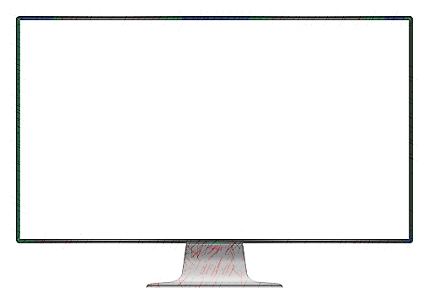


A Decentralised Censorship resistant social media on the Ethereum Blockchain.

